Slide 1
WoT in Convenience
Munich, Germany
June 5, 2019

Slide 2
Fueling Convenience Retail (US)
165 million on-site customers every day
$654 billion dollars in 2018
154,000 store locations
70,000 stores owned in groups of 1 or 2
Effective product control is crucial

Slide 3
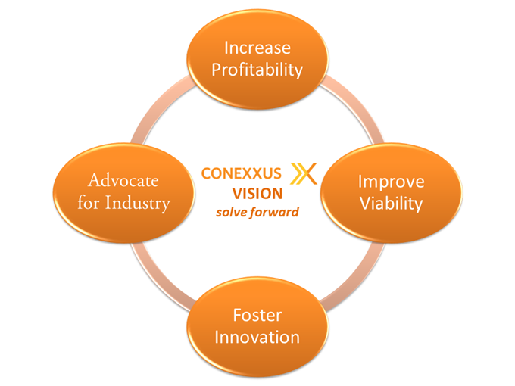
You Have a Technology Partner…
We are independent & non-profit…
Expert volunteers, shaping the industry
We set standards…
Data exchange, security, payments
We provide clarity…
Emerging tech/trends; identifying & educating
We advocate for our industry…
Open standards, innovation & competition
We improve profitability
Notes:
Small staff of 5 – we rely on members to do the heavy lifting

Slide 4





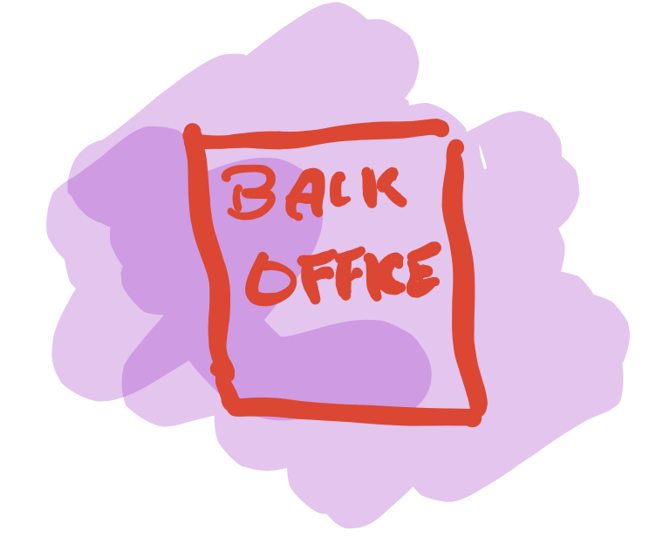


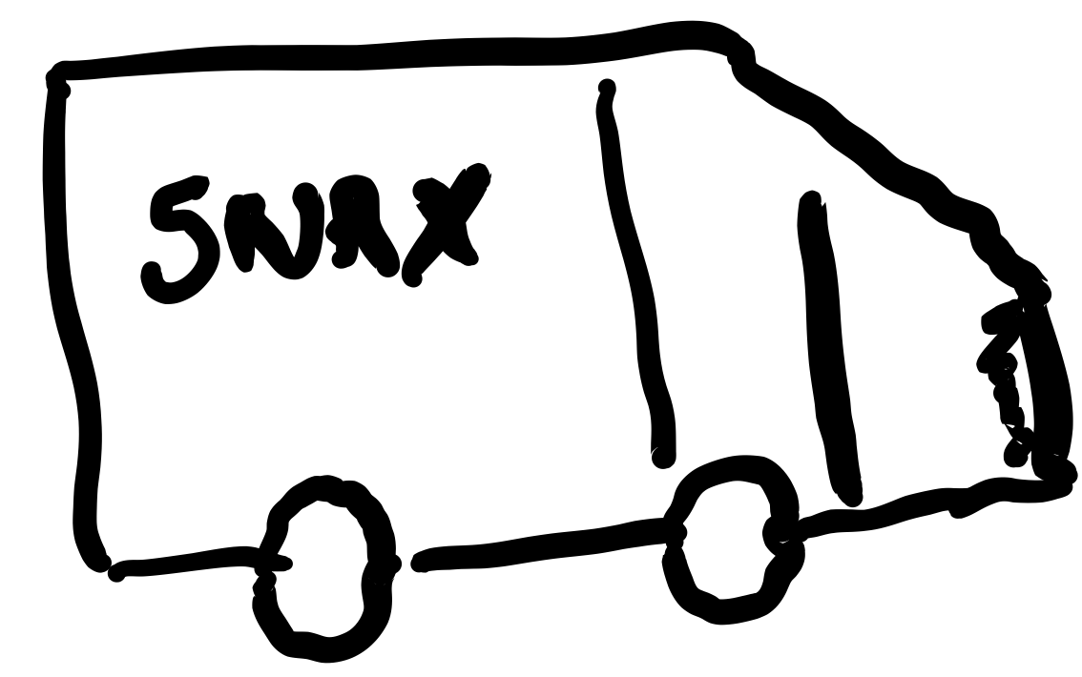

Slide 5
Conexxus Standards
Electronic Payment Server
Forecourt Device Controller
Lottery Interface
Loyalty Interface
Mobile Payments
Motor Fuel Interface
OSA (Open Site Architecture)
Core
Reference Model
Safe
Sign
Payment System Product Codes
Point-to-Point Encryption
POS/Back Office Interface
Retail Merchandise Interface
Site Asset
Notes:
Blain 1 Minute.

Slide 6







Slide 7
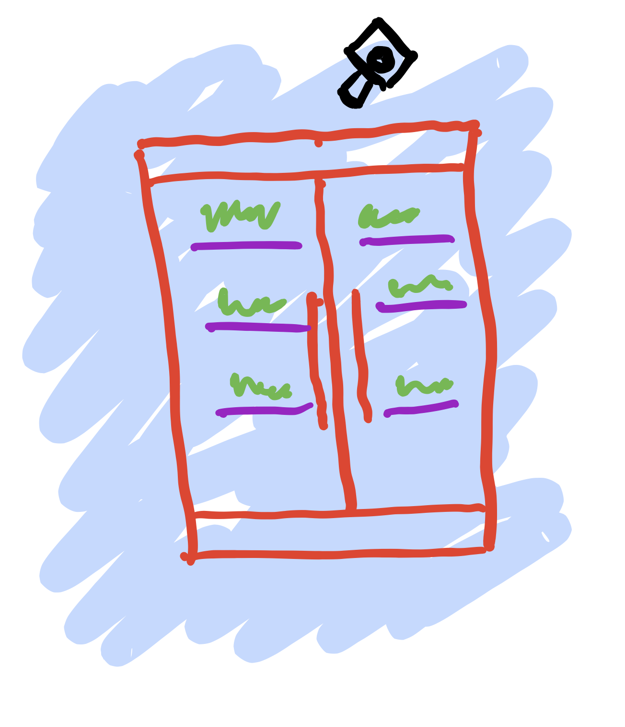
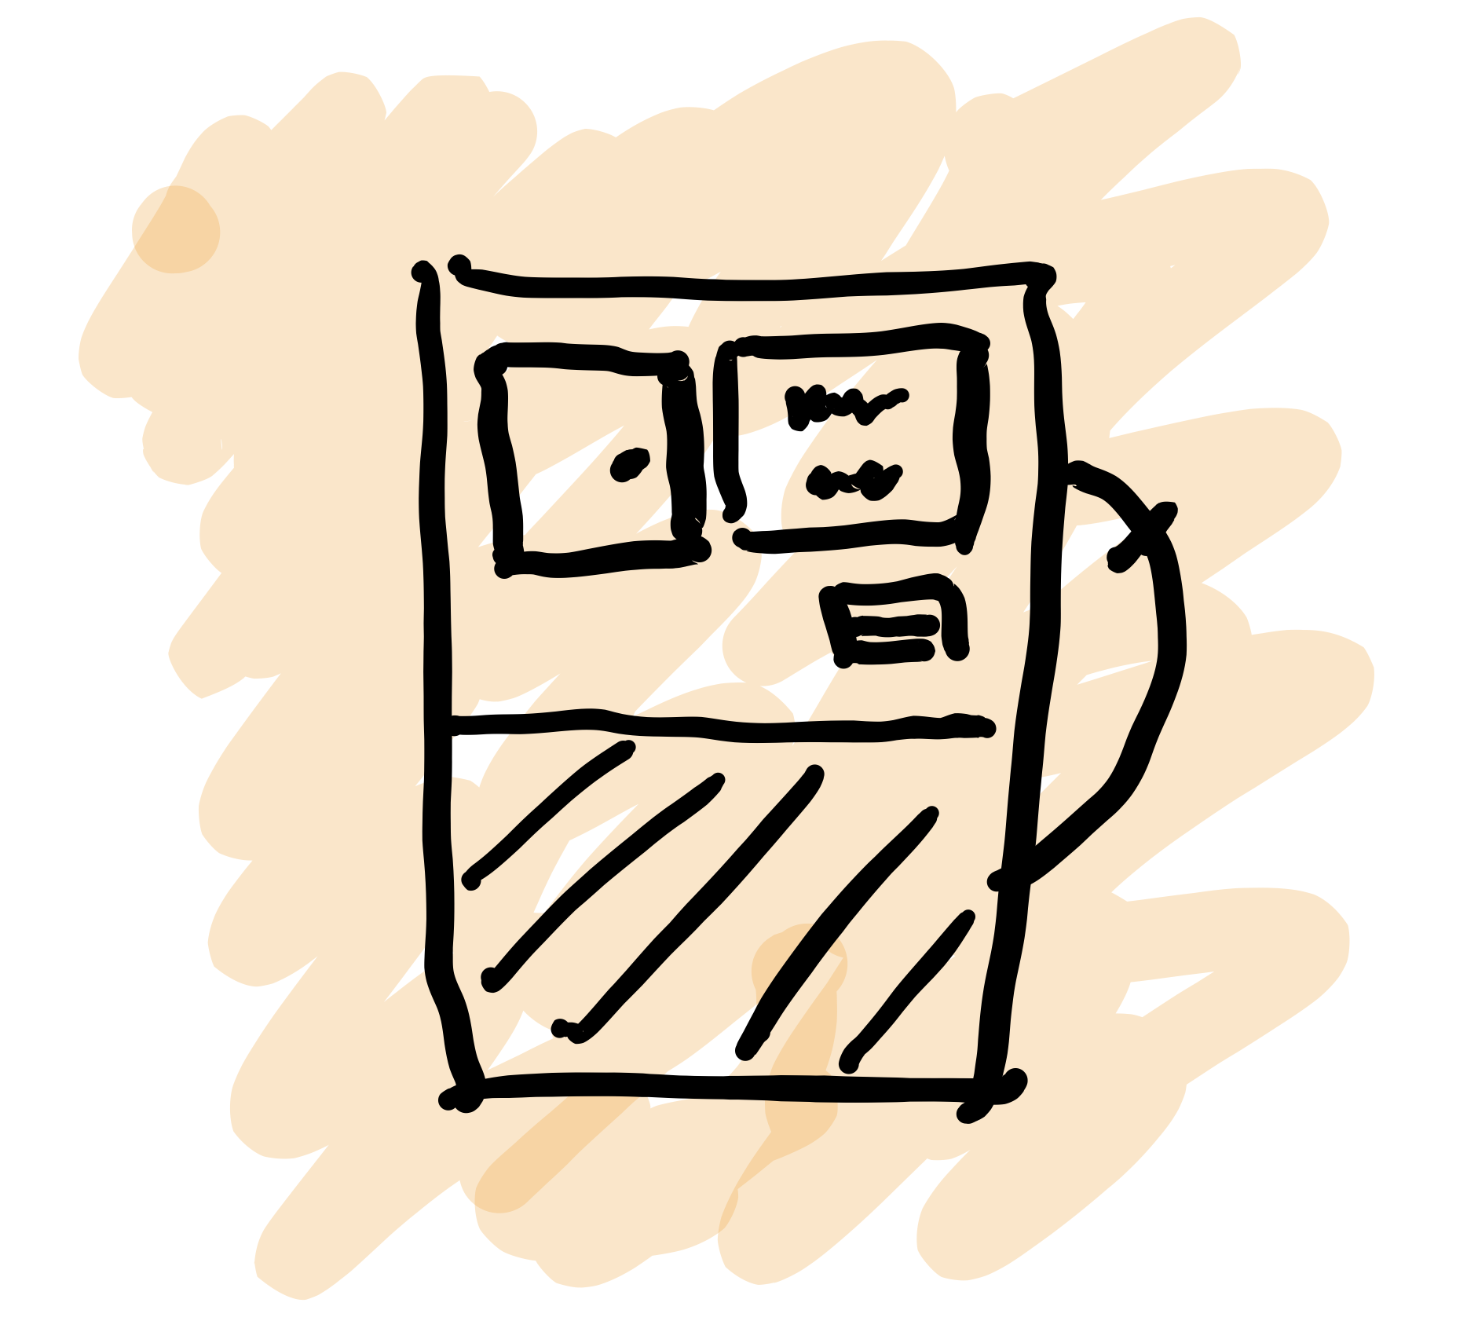

Slide 8


Slide 9
5 Year Outlook

Slide 10



































Home
Shop/Deliver
In-app web
Shop/Deliver
Vendor Data
Exchange
IOT Web Events
Digital CRM
Predictive
Analytics
RPA
Mobile
Checkout
Advanced
Analytics
HQ/Admin
Promotion
Loyalty
Payments
Cloud
Mobile
Segment
AV store
Delivery
Back Office
Augmented
Employees
RPA
IOT Plant
Mgt.
IOT Food Safety
IOT Tracking
Checkout
Blockchain
Order to $
NextGen
Data & Store
Security
Forecourt
Transaction
Segment
Payments
AI Checkout
IOT Media
Baseline
Now
3 to 7 years
1 to 5 years
5 years +
Notes:
Baseline – standard POS systems that support payments and report through back office systems to headquarters are the basic configuration.
Now – cloud-based loyalty systems provide access to promotions and alternative payments. These “walled-garden” systems will be limited in their consumer reach.
1 to 5 years – improved store security and mobile checkout (BYOD) will become prevalent. Data analytics and cloud based AI systems will focus on knowing consumers. Device management through IoT becomes crucial. AI based (scannerless) checkout will become widespread.
3 to 7 years – a slew of new capabilities linked to IoT tracking of resources, media (software), and consumer devices will emerge, and robotic process automation will take center stage.
5+ years – store personnel and consumers will access new UX/CX innovations through augmented reality. Distributed digital ledger “validation” and “provenance” technologies will become widespread, and automated vehicles will be both serviced and used by store operations.

Slide 11
Thanks

